Slide 1
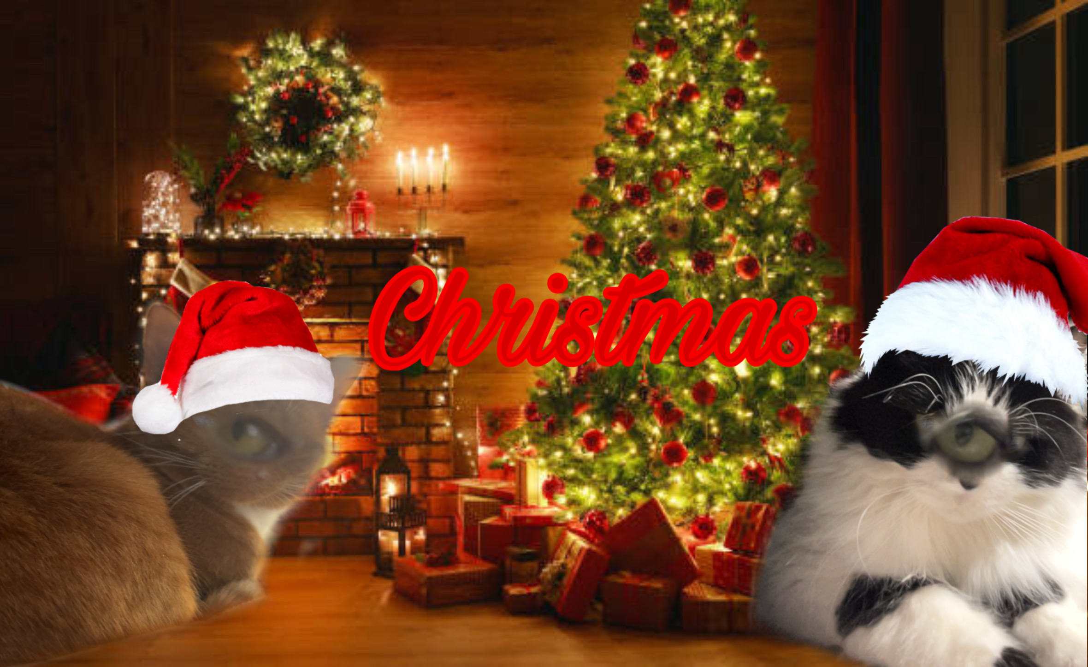

Slide 2
Chicago on wednesday january 21st
Ill buy my own concert ticket i just need a way to chicago 😭😭😭😭😭😭😭😭All i want😭😭😭😭😭😭😭😭😭😭😭😭😭😭😭😭😭😭😭😭😭😭😭😭😭😭 Someone

Slide 3
Stocking
Blind bags go to five below
Pimple patches

Slide 4
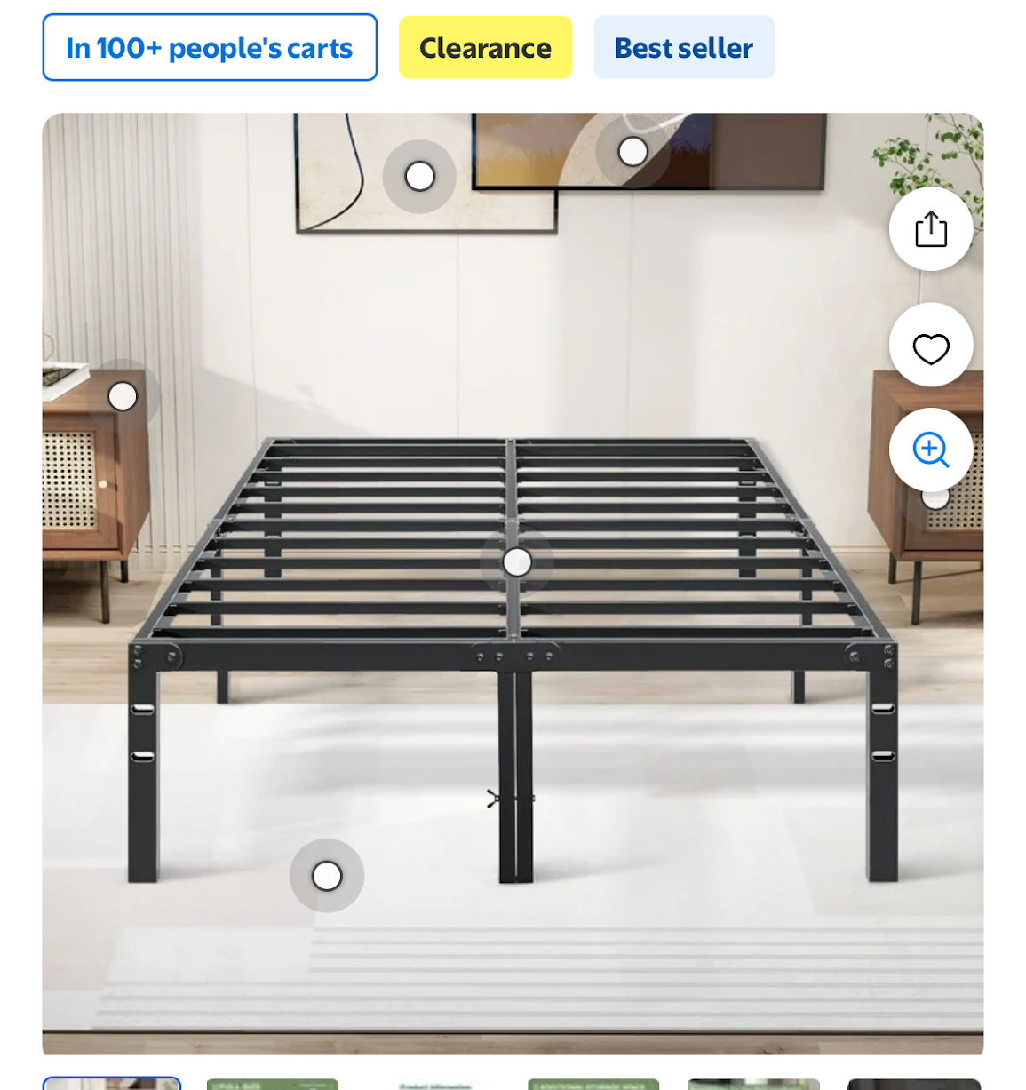
Bed full size
And mattress no more loft bed

Slide 5
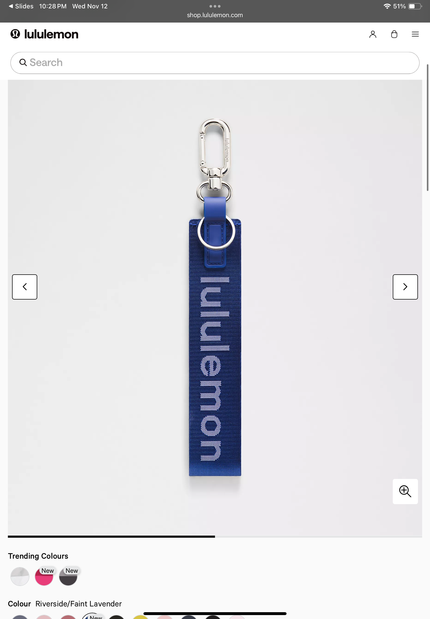
Key chain
I want the black and
Gold one not this one

Slide 6
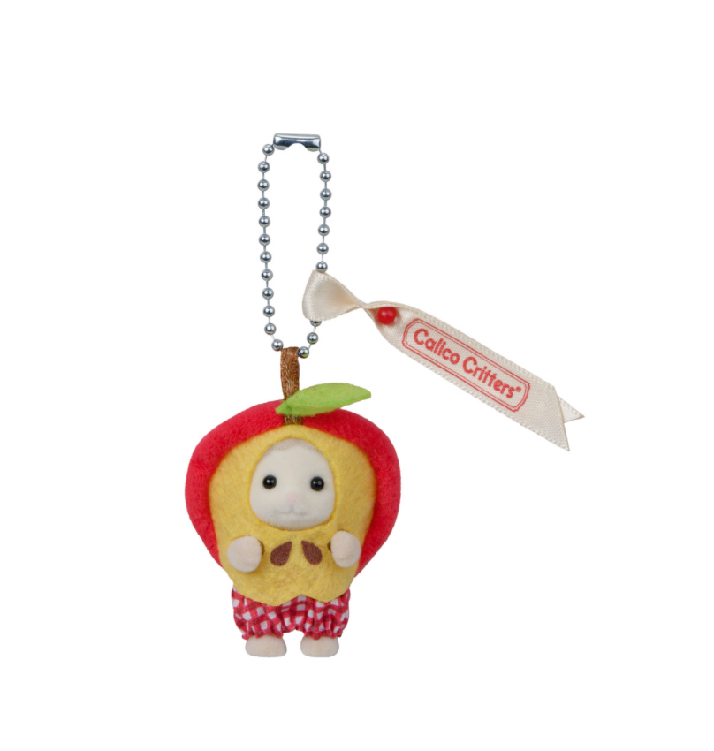
Key chain to put on the other keychain

Slide 7
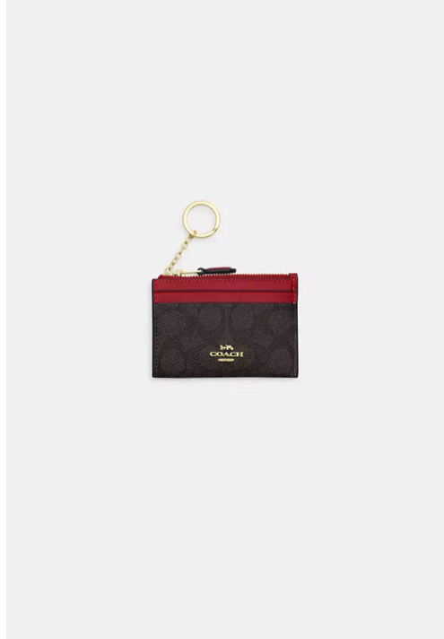
Wallet
I like the red one but black and gold
If they don’t have

Slide 8
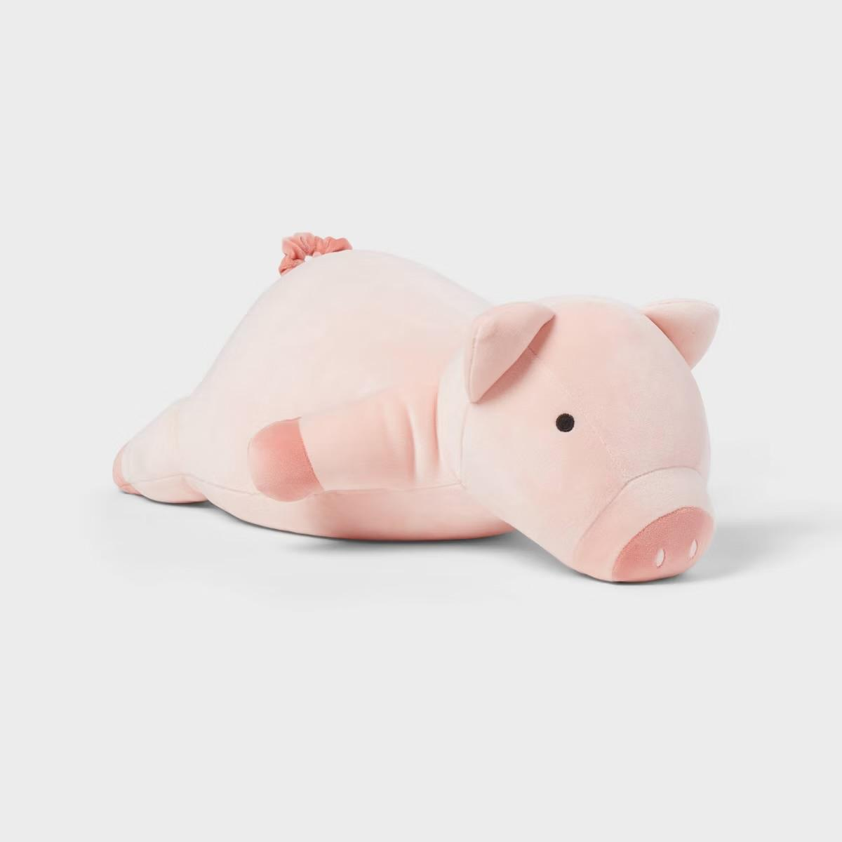
Pig

Slide 9

Hair oil
Small one

Slide 10
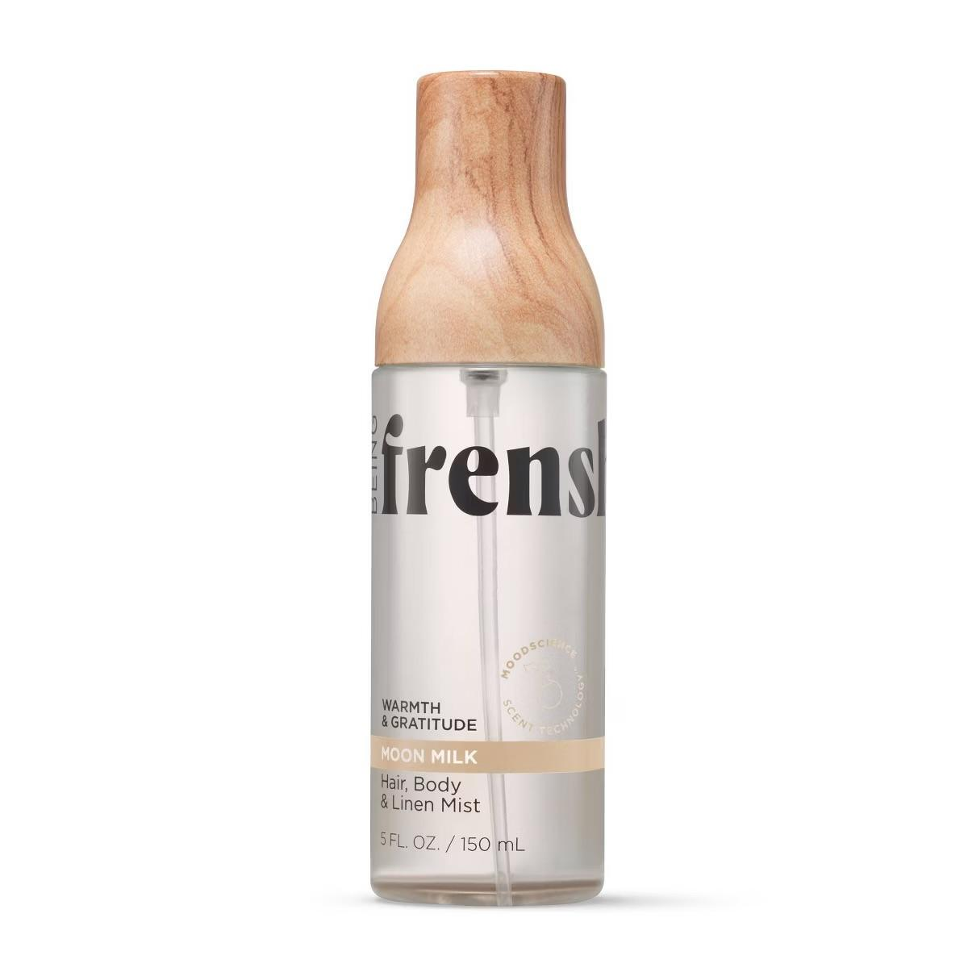
Perfume
Moon milk

Slide 11
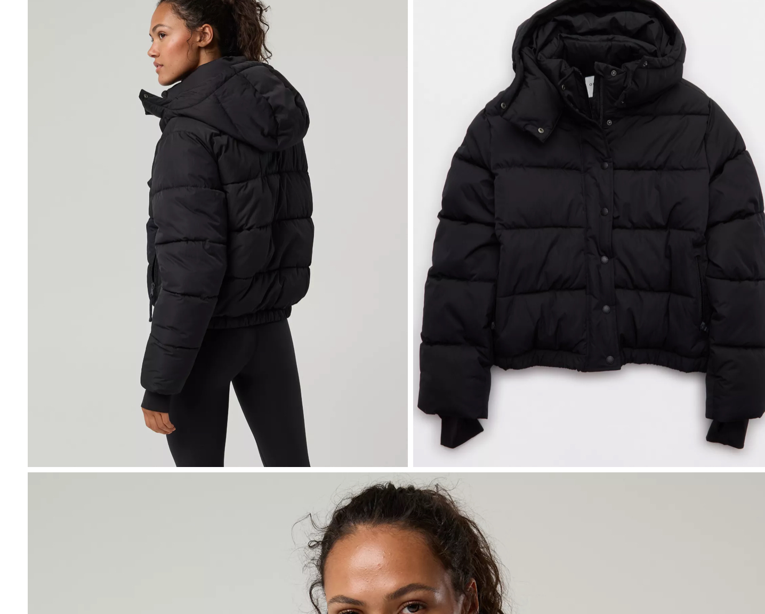
Puffer
Medium

Slide 12
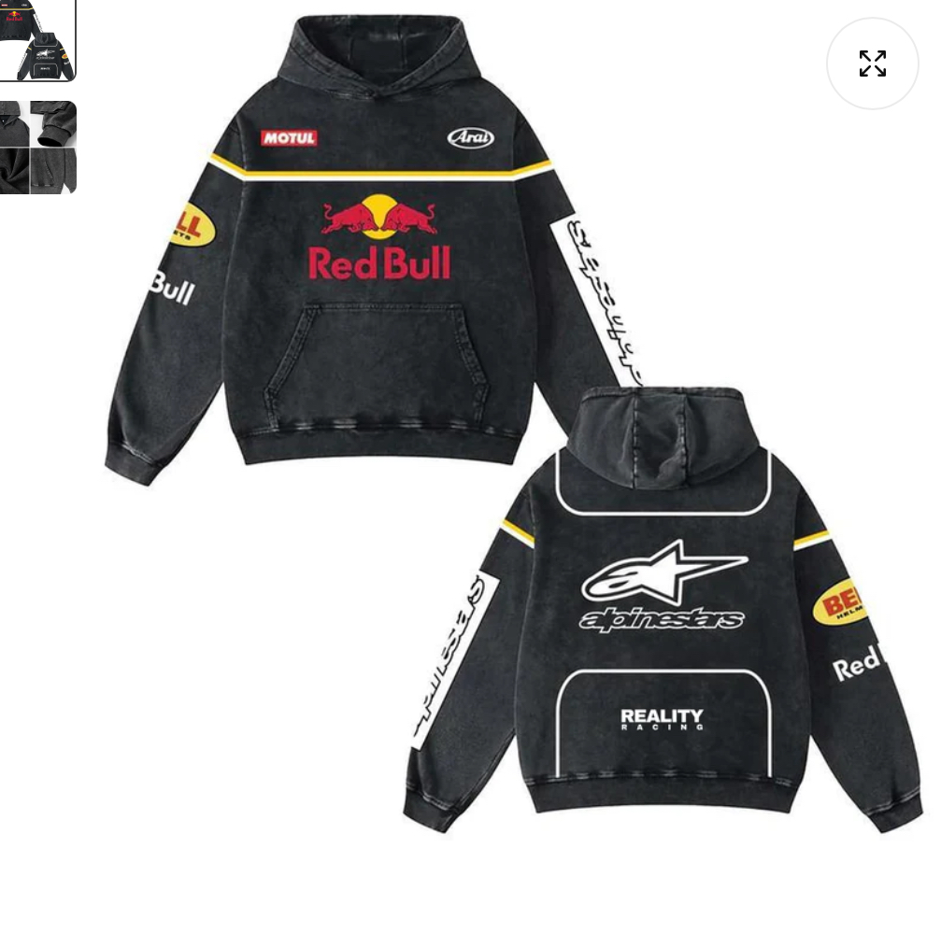
Hoodie
Large
50% off rn

Slide 13
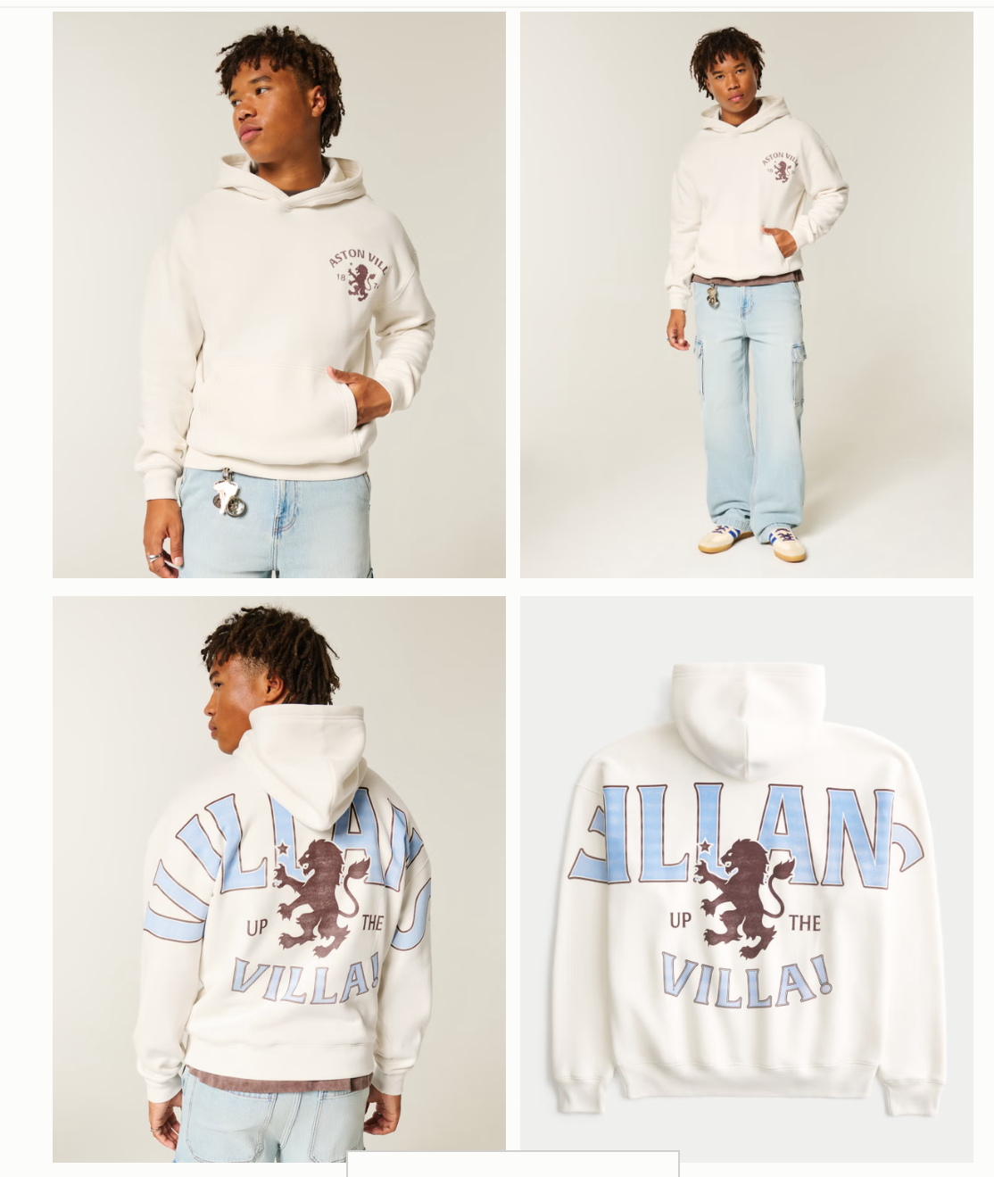
Hoodie
large

Slide 14
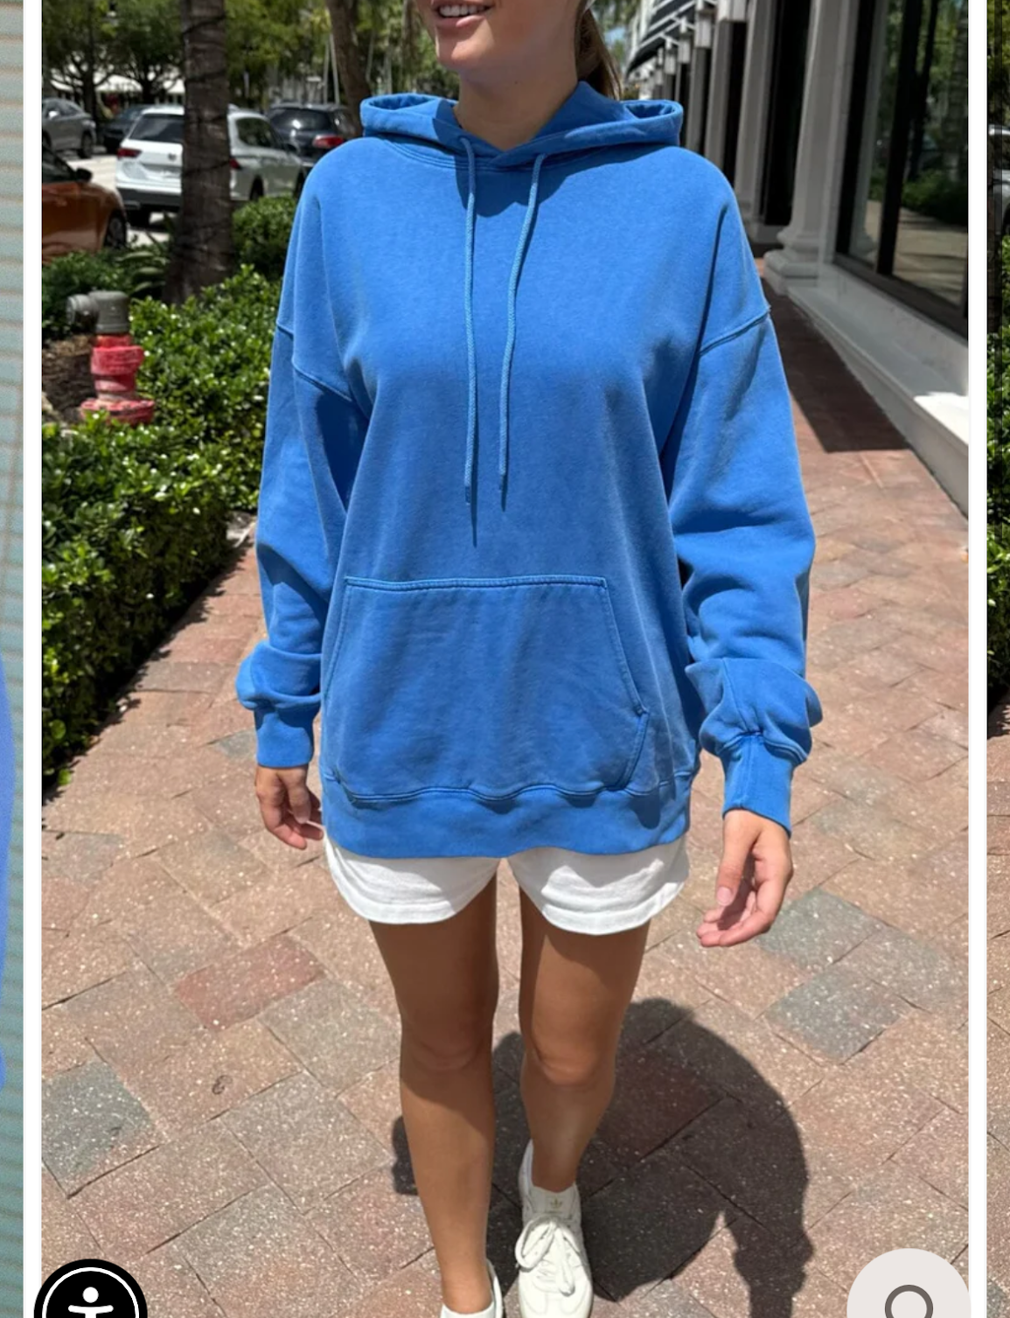
Hoodie

Slide 15
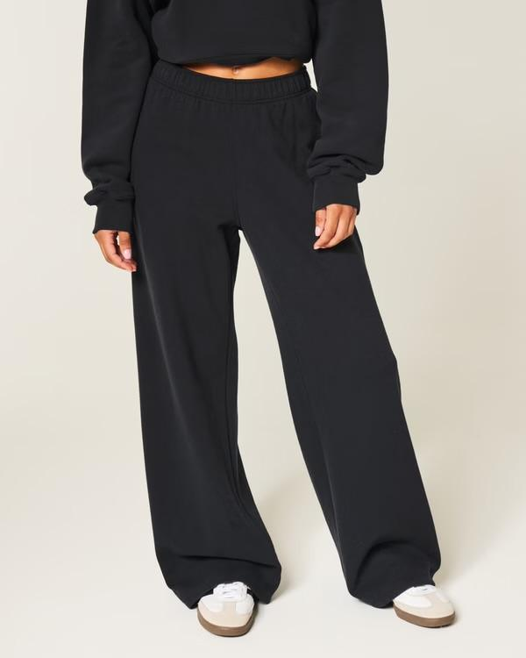
Pants
Medium

